Slide 1
QUANTUM GATES
Lucas Nunes

Slide 2
CONTENT
Introduction
Quantum bits
Quantum gates
Applications
Conclusion

Slide 3
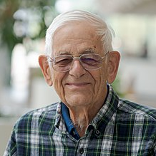
Introduction
Paul Benioff (1980)

Slide 4

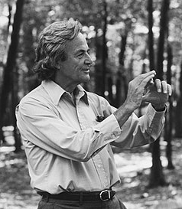
Introduction
Paul Benioff (1980)
Richard Feynman and Yuri Manin (1986)

Slide 5

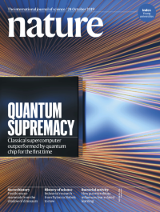
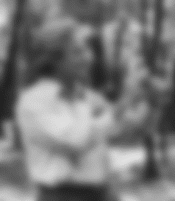
Introduction
Paul Benioff (1980)
Richard Feynman and Yuri Manin (1986)
Quantum supremacy, Google (2019)

Slide 6
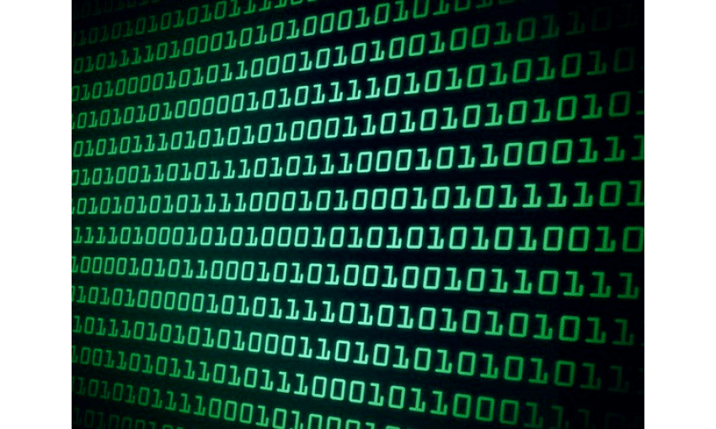

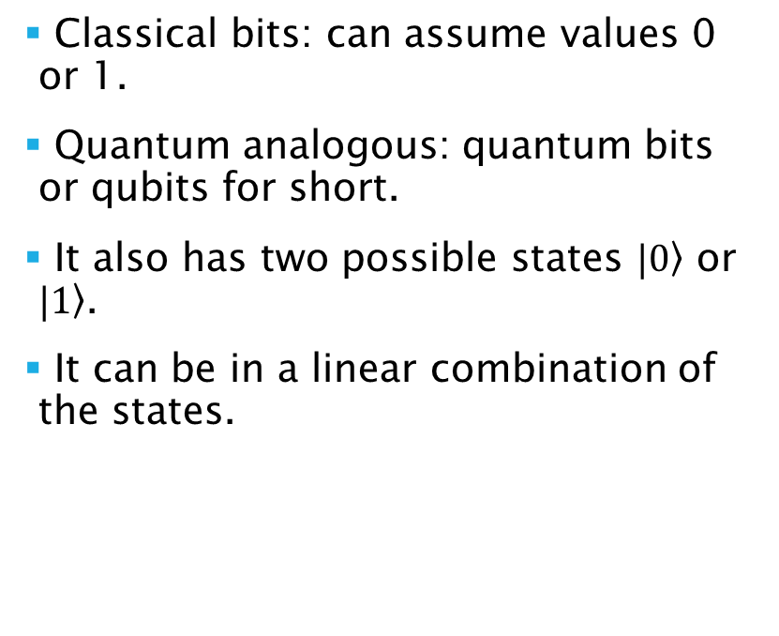
Quantum bits
Classical bits: can assume values 0 or 1.
Quantum analogous: quantum bits or qubits for short.
It also has two possible states $|\left.0\right\rangle$ or $|\left.1\right\rangle$.
It can be in a linear combination of the states.

Slide 7

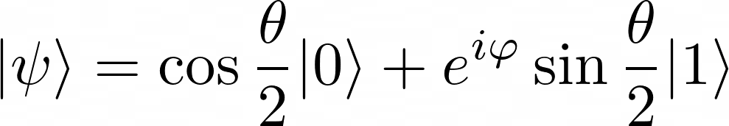
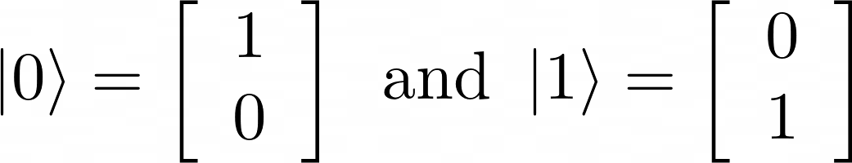
Quantum bits
The information about qubits are limited.
We can represent the states in as vectors:
We can write, the state of a qubit as

Slide 8
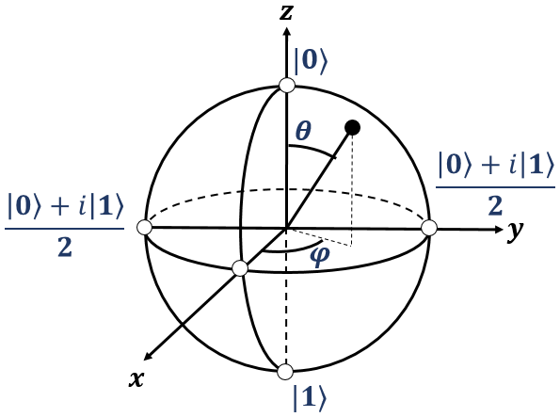
Quantum bits
The information about qubits are limited.
We can represent the states in as vectors:

Slide 9
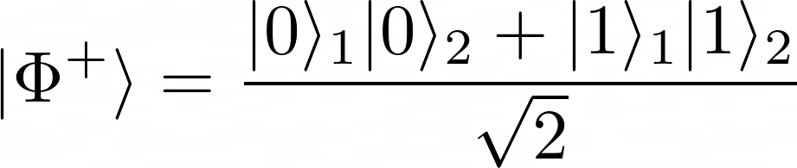
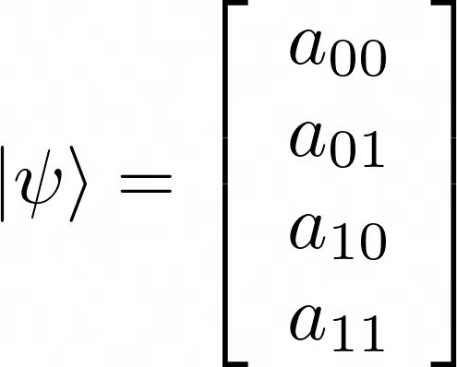
Quantum bits
To perform useful computation it is necessary at least two qubits.
The state is written as
We can prepare a Bell state (or EPR pair).

Slide 10


Quantum bits
The Bell state:
If the first spin is measured two results are possible:
0 with 50% probability leading to state
Or 1 with 50% probability leading to state
The measurement outcomes are correlated.

Slide 11
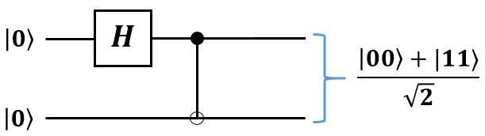
Quantum bits
The Bell state:

Slide 12
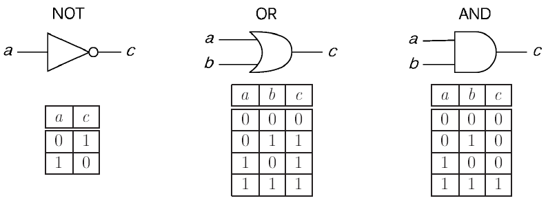
Quantum gates
In classical computing the information (carried by bits) can be stored in HD’s or transformed by logic gates.

Slide 13
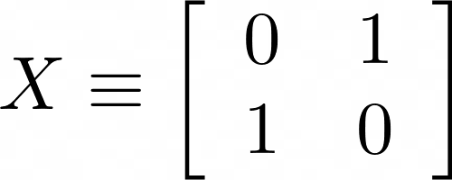
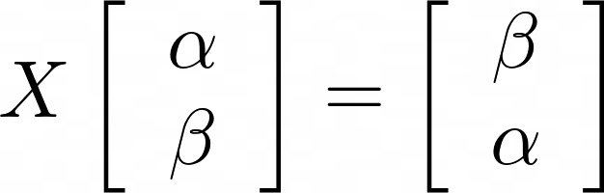
Quantum gates
We can look to a quantum analogous of the NOT gate, which acts linearly,so
We can represent the NOT gate in matrix form

Slide 14
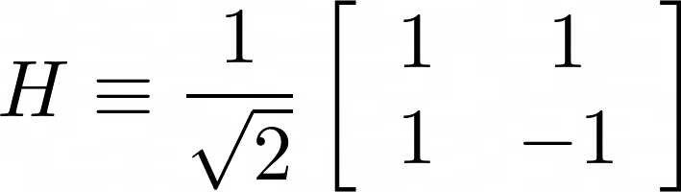
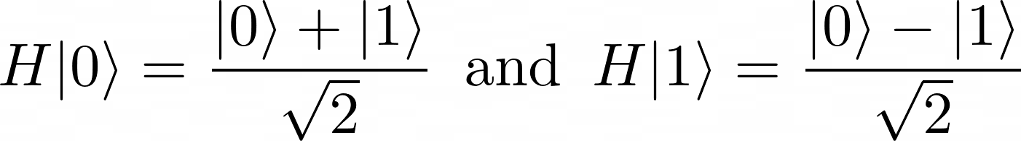
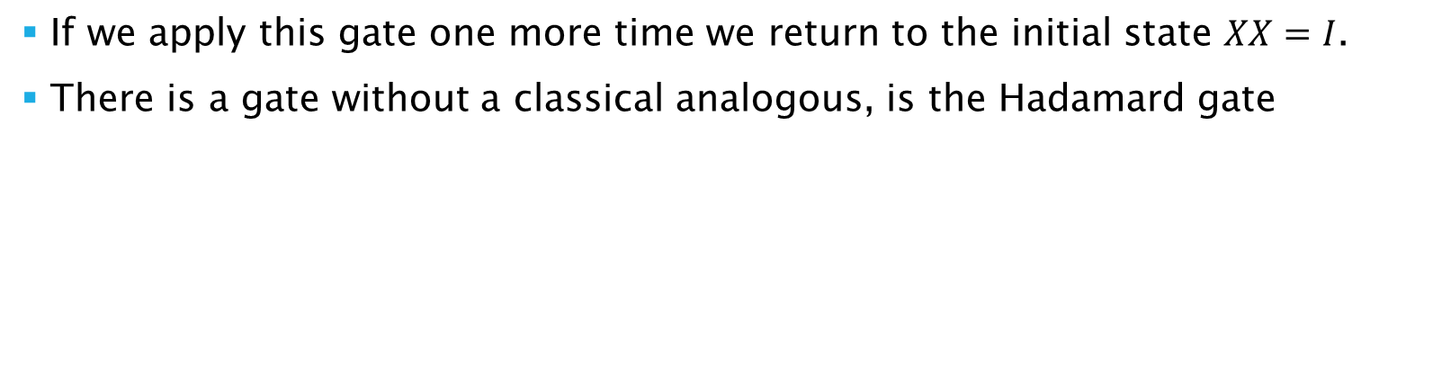
Quantum gates
If we apply this gate one more time we return to the initial state $XX=I$.
There is a gate without a classical analogous, is the Hadamard gate
It creates the superposition of states:

Slide 15
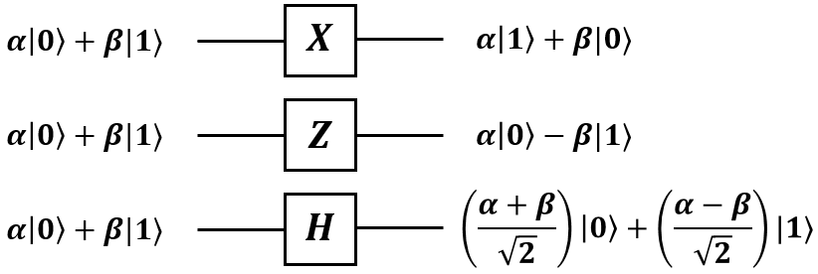
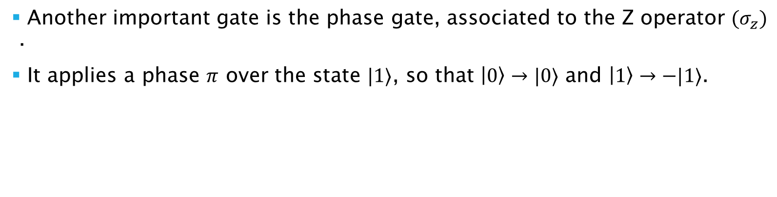
Quantum gates
Another important gate is the phase gate, associated to the Z operator $(σ_{z})$ .
It applies a phase $π$ over the state $|1〉$, so that $|0〉→|0〉$ and $|1〉→−|1〉$.

Slide 16



Quantum gates
There are infinite gates for one qubit
They must be reversible, i.e, $U^{†}U=I$
Note that $X,Z$ and $H$ are unitary operators.

Slide 17




Quantum gates
Any logic gate of one qubit can be represented using a combination of rotations as
This is representes the rotation of the Bloch vector by an angle $θ$ around a $\hat{n}$ axis.

Slide 18
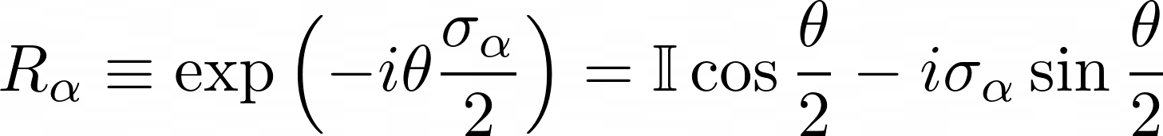

Quantum gates
The Z gate can be represented by a rotation about the $\hat{z}$ axis of 180º.
The X gate is a rotation about the $\hat{x}$ axis of 180º (or a $π$ pulse).
The H gate is a rotation about the $\hat{y}$ axis of 90º (or a $π/2$ pulse).

Slide 19
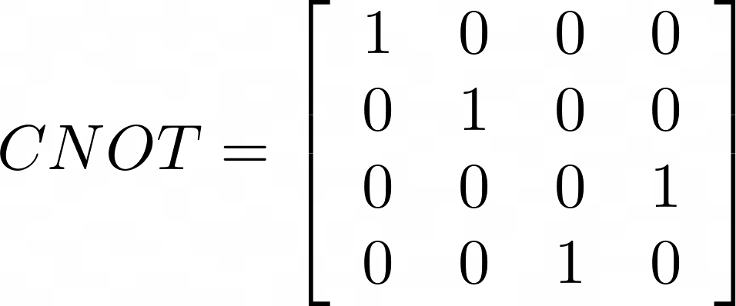
Quantum gates
The mult-qubit quantum logic gate is the controlled-NOT or CNOT.
It has two qubits input: target and control. In matrix format

Slide 20
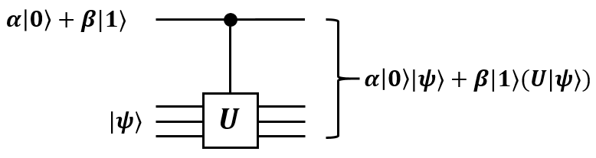

Quantum gates
If $U$ is a logic gate which acts on $n$ qubits. One can define the controlled-U gate.

Slide 21
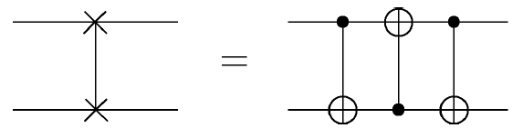

Quantum gates
Other two important controlled gates are the controlled phase gate and the SWAP gate.
The CtrlZ gate adds a $π$ phase only to $|11〉$ state. The Swap gate exchange the state of two qubits.

Slide 22
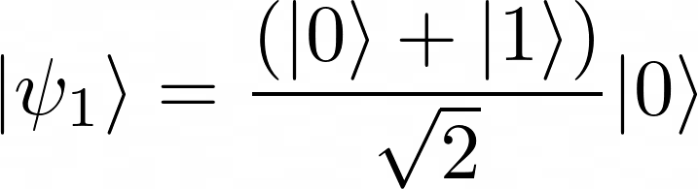
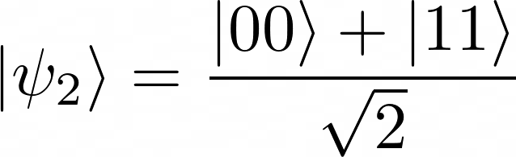

Applications
Bell state

Slide 23
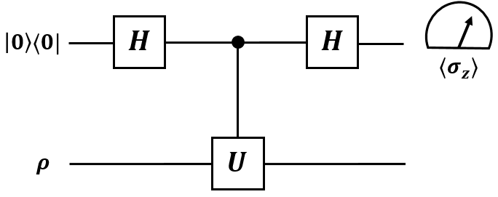

Applications
Scattering circuit
By measuring the expectation values $〈σ_{z}〉$ and $〈σ_{y}〉$ one can obtaing information about the interaction $U$ or the input state $ρ$.

Slide 24
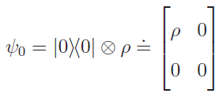
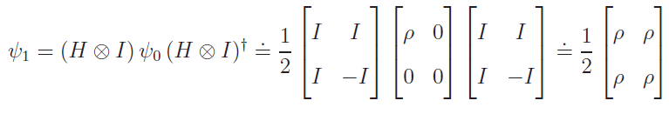
Applications
Scattering circuit

Slide 25
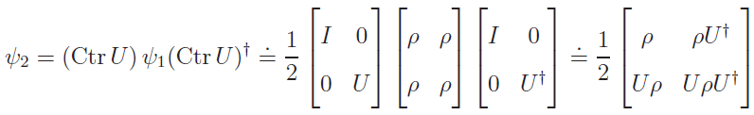
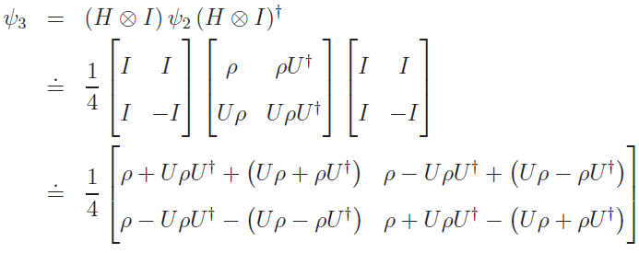
Applications
Scattering circuit

Slide 26
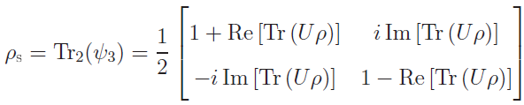
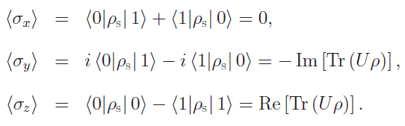
Applications
Scattering circuit

Slide 27

Applications
Quantum teleportation
$$|ψ〉$$

Slide 28
Applications
Quantum teleportation
She interacts the qubit unknow with her half of Bell state
The result will be: 00, 01, 10 or 11.
She sends this information to Andre.
Depeding on Thalyta’s message, Andre performs one of four operations on his half of Bell state.

Slide 29
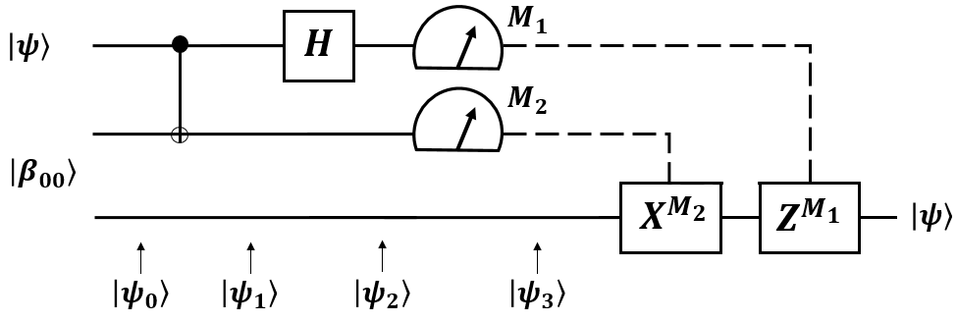
Applications
Quantum teleportation

Slide 30

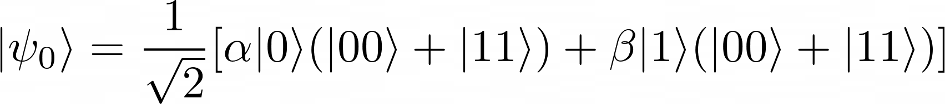
Applications
Quantum teleportation

Slide 31
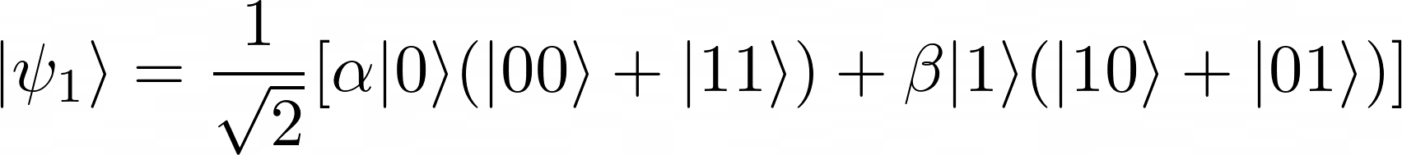
Applications
Quantum teleportation

Slide 32
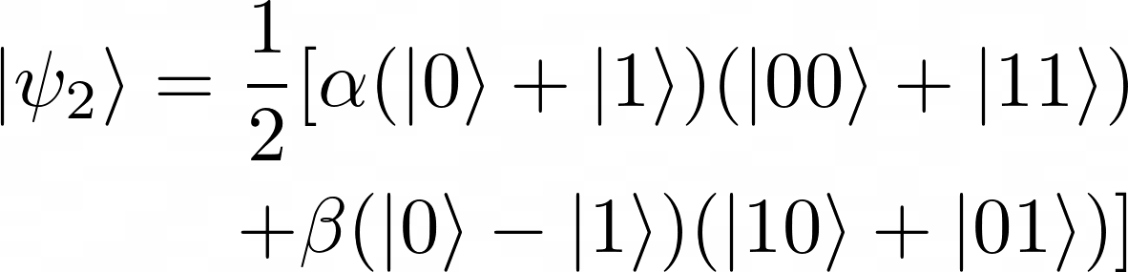
Applications
Quantum teleportation

Slide 33
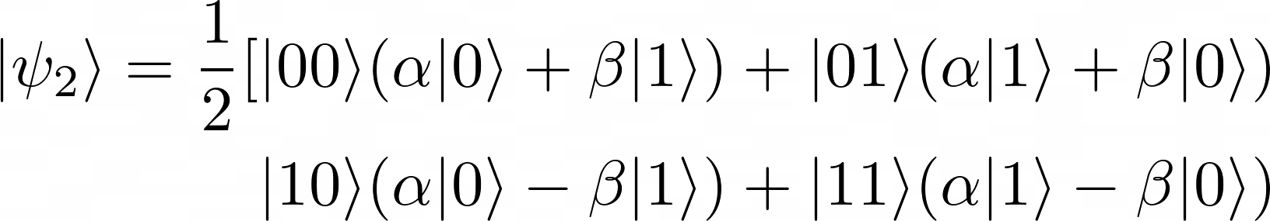
Applications
Quantum teleportation

Slide 34
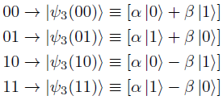
Applications
Quantum teleportation

Slide 35
Applications
Quantum teleportation

Slide 36
Conclusion
In this work make a brief description of qubits and quantum gates.
Made a few examples of quantum circuits.
Quantum gates are a essential part of quantum computing and quantum information processing.

Slide 37
Muito obrigado

